Slide 1

COEN 166 Lab Assignment 2 Instruction

Slide 2
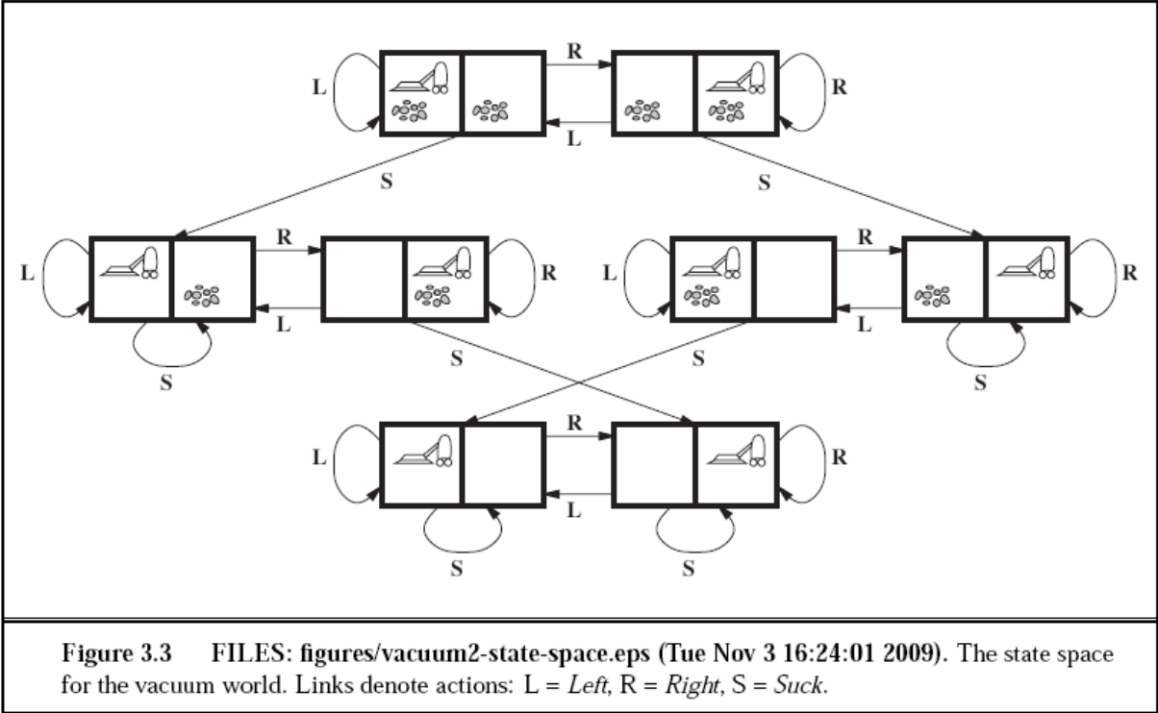
Vacuum Cleaner Agent

Slide 3
Requirements
Define the “state” as a list of three elements: the 1st element specifies the status of the left square (“Clean” or “Dirty”), the 2nd element specifies the status of the right square (“Clean” or “Dirty”), and the 3rd element specifies the current location of the agent (0 for left square, 1 for right square).
The candidate actions are “Suck”, “Left” (moving to the left square), “Right” (moving to the right square). Each action costs 1 point.
The agent will take an action based on the current state. The agent program can update the state immediately after an action is taken. The program terminates when both squares are clean.

Slide 4

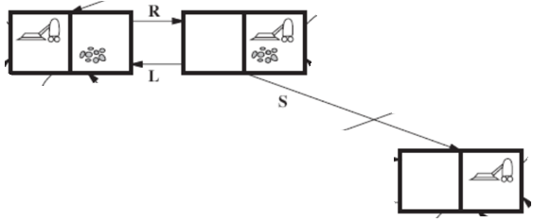
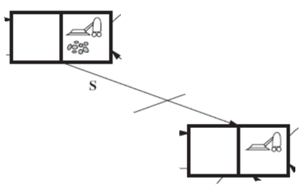
Different Initial State

Slide 5
Functions
How to run a goal test (i.e. check whether the current state is a goal state)?
def goal_test(self, state):
if xxx: return True
else : return False

Slide 6
Testing
Create a test case to verify your code. The test case takes two inputs: the current state, and an empty list that will store the actions; then it will generate two outputs: the sequence of actionstaken by the agent to achieve the goal state, and the corresponding total cost.
Your test case should be able to take any possible inputs, generate the corresponding outputs, and verify whether the outputs are correct or not. For example, if the outputs are correct, then your test code can print a message: “Correct Outputs!” Otherwise, it can print: “Wrong Outputs!”

Slide 7
Testing
Import unittest
class Testlab2(unittest.TestCase):
def test_lab2(self):
self.assertEqual(xxx)
……
if __name__==‘__main__’:
unittest.main()
Can also use your own way to do the test case, it’s not mandatory to use “unittest”

Slide 8
Demo
• How to run a goal test (i.e. check whether the current state is a goal state)?
• How to determine an action for the current state?
• How to update the state after an action is taken?
• Run a test case

Slide 9
Report
Need to include explanations of the code. If no explanation or very little explanation, points will be deducted.
Please follow the report sample PDF.

